Slide 1

EXTRACTING FEATURES FROM FINANCIAL DOCUMENTS FOR PREDICTING
FIRM PERFORMANCE
Cem Sinan Ozturk, Tyler Roberts, Ted Thompson, Duong Vu

Slide 2

UBC Sauder School of Business Partners
MANAGEMENT INFORMATION SYSTEMS RESEARCH
Accounting and Information Systems Division
Faculty Members:
Hasan Cavusoglu - Associate Professor
Research: Economics of Information Systems
Game Theory, Econometrics, Social/Behavioral Science methods
Gene Moo Lee - Assistant Professor
Research:
Topics: Industry Intelligence, Mobile Ecosystem, Social Media, Cybersecurity

Slide 3



Who We Are – Why Are You Listening To Us?
Advisor: Dr. Mike Gelbart
Department of Computer Science

Slide 4




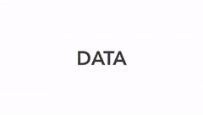
Who We Are – Why Are You Listening To Us?
Meet our team
Tyler Roberts
Duong Vu
Cem Sinan Ozturk
Ted Thompson

Slide 5

Agenda
Problem Statement
Data Overview
Scientific Objectives
Final Products
Future Works
Methods

Slide 6
Problem Statement
10 Gb
Fundamental Financial metrics
11M
SEC Fillings
Predicting firm performance
Predicting firm survival
Notes:
Sauder School of Business has scraped more than 11M SEC filings and would like to use the information from this text, along with standard financial features for several of their research projects.

Slide 7
Problem Statement
What is Natural Language Processing (NLP)?
Artificial Intelligence: Computer systems which are able to perform tasks that normally require human intelligence.
Linguistics: Scientific study of human language and its structure
The goal: Have computers understand human language in order to perform useful tasks like classification, translation, or clustering.
Artificial
Intelligence
NLP
Linguistics
Notes:
Sauder School of Business has scraped more than 11M SEC filings and would like to use the information from this text, along with standard financial features for several of their research projects.

Slide 8
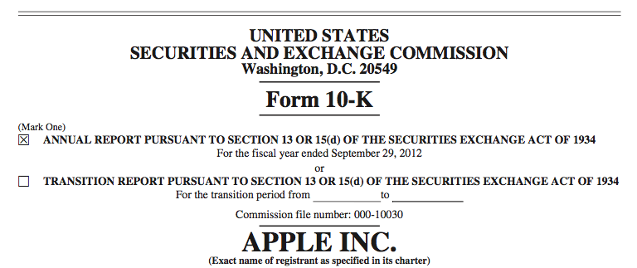
Data Overview
Notes:
Text Document that we have: 10K Filings. Sauder School has parsed the data for us to use

Slide 9
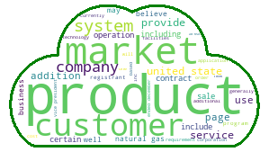
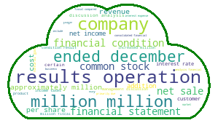
Data Overview
Item 1
Overview about the company
Item 7
Management’s Year End Discussion
MongoDB – 10-K data
Notes:
Our focus is 2 items: item1 and item 7. When using all text form item 1 and item 7 to plot a WordCloud, you can see the topic of these items: Item1 – Description of company; Item7 – Risk, year end.

Slide 10

Data Overview
Firm performance → Create labels using stock returns as a proxy

Slide 11
Scientific Objectives
Extract useful features from SEC Fillings
Develop modular pipeline combining data sources that partners can use in their research.
Predictive models to demonstrate usefulness of extracted features

Slide 12
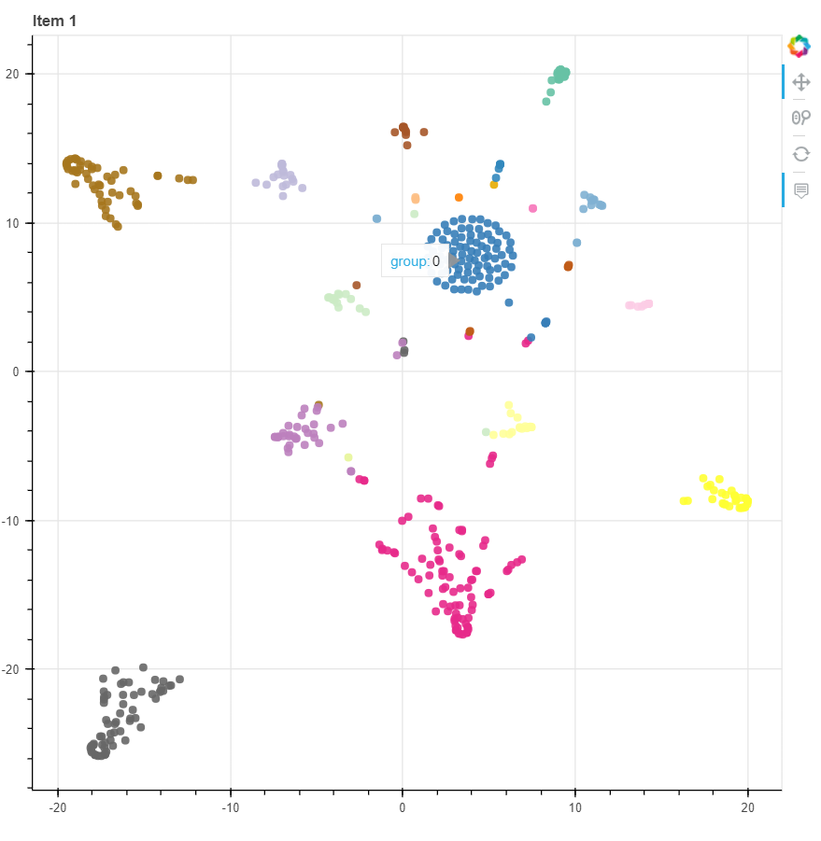
Method
Exploratory Data Analysis
Database: SQL, noSQL (MongoDB), …
Wrangling: pymongo, missingno,…
Visualization: matplotlib, seaborn,
Bokeh, pyLDAvis,…
T-SNE

Slide 13
Method: Modelling
Sentiment Analysis
I love UBC
Negative vs. Positive
Polarity
1
-1.0 → +1.0
Objective vs. Subjective
Subjectivity
0.75
0 → +1.0
Uncertainty vs. Certainty
Modality
0.5
-1.0 → +1.0

Slide 14
Method: Modelling
Sentiment Analysis
I hope to get into UBC
Negative vs. Positive
Polarity
0
-1.0 → +1.0
Objective vs. Subjective
Subjectivity
0
0 → +1.0
Uncertainty vs. Certainty
Modality
- 0.25
-1.0 → +1.0

Slide 15
Method: Modelling
I hope to get
into UBC
Sentiment Analysis
I love UBC
Polarity
1
0
Subjectivity
0.75
0
Modality
0.5
- 0.25

Slide 16
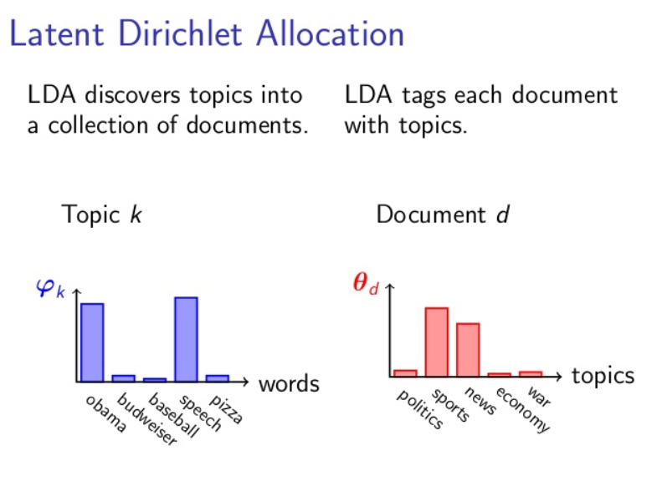
Method: Modelling
Latent Dirichlet Allocation
Non-negative Matrix Factorization
Topic Modelling

Slide 17
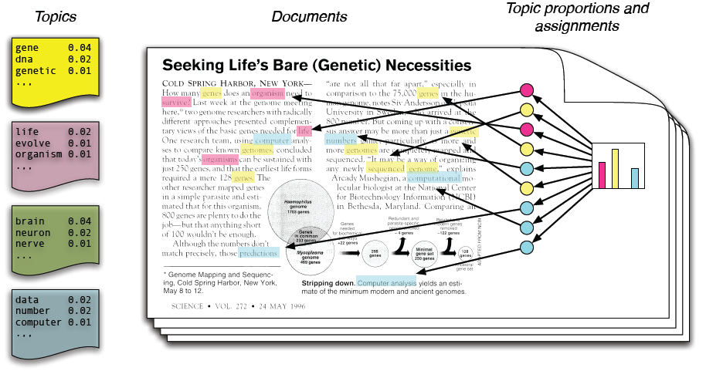
Modelling: Latent Dirichlet Allocation
https://bcatctr.github.io/paraLDA

Slide 18
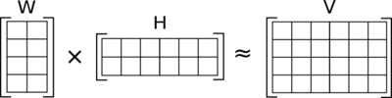
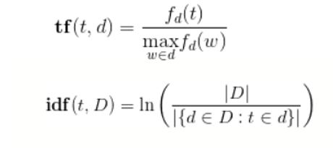
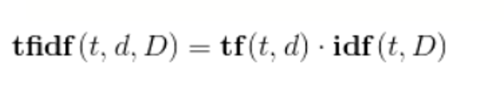
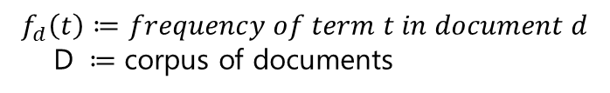
Method: Modelling
Latent Dirichlet Allocation
Non-negative Matrix Factorization
Topic Modelling
$$f_{d}\left(t\right)≔frequency of term t in document d$$
D $≔$ corpus of documents

Slide 19
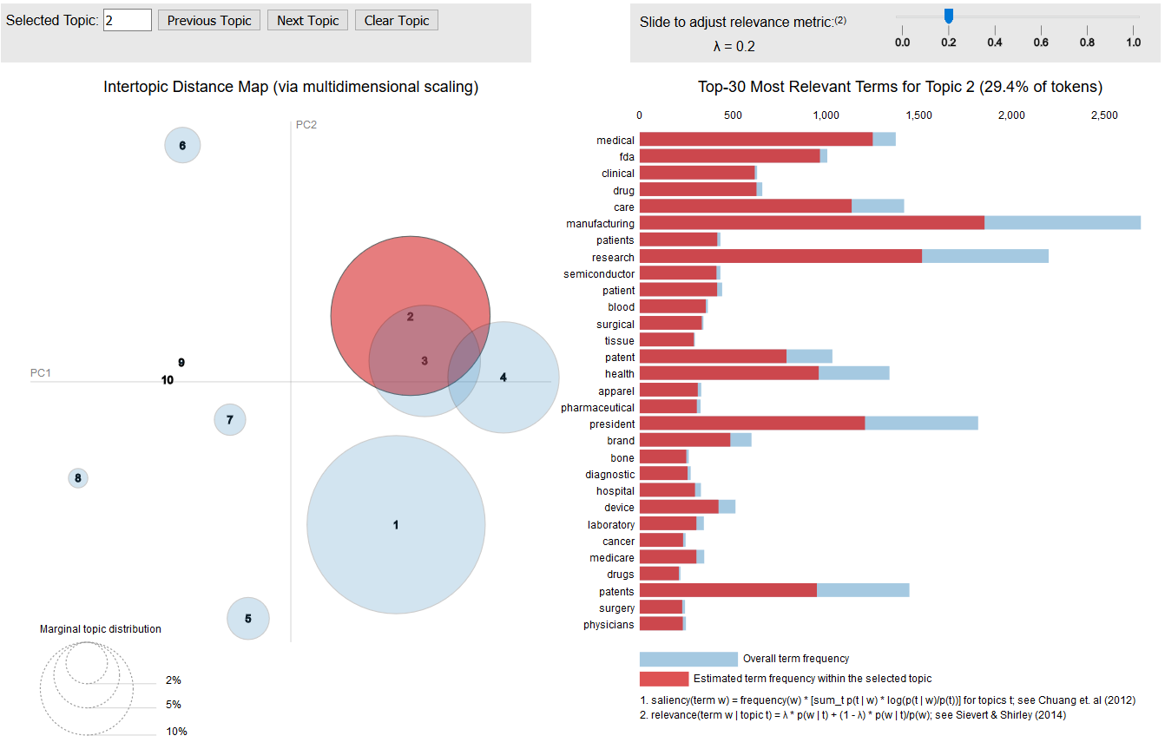
Method
Modelling
Topic Modelling:
1) LDA from gensim model
2) CountVectorizer & LDA from sklearn library
3) TF-IDF & NMF model from sklearn library
LDA

Slide 20
Method
Prediction
Logistic Regression
Random Forest Classifier
k-Nearest Neighbors
Support Vector Machine
Feed Forward Neural Network
Modelling

Slide 21
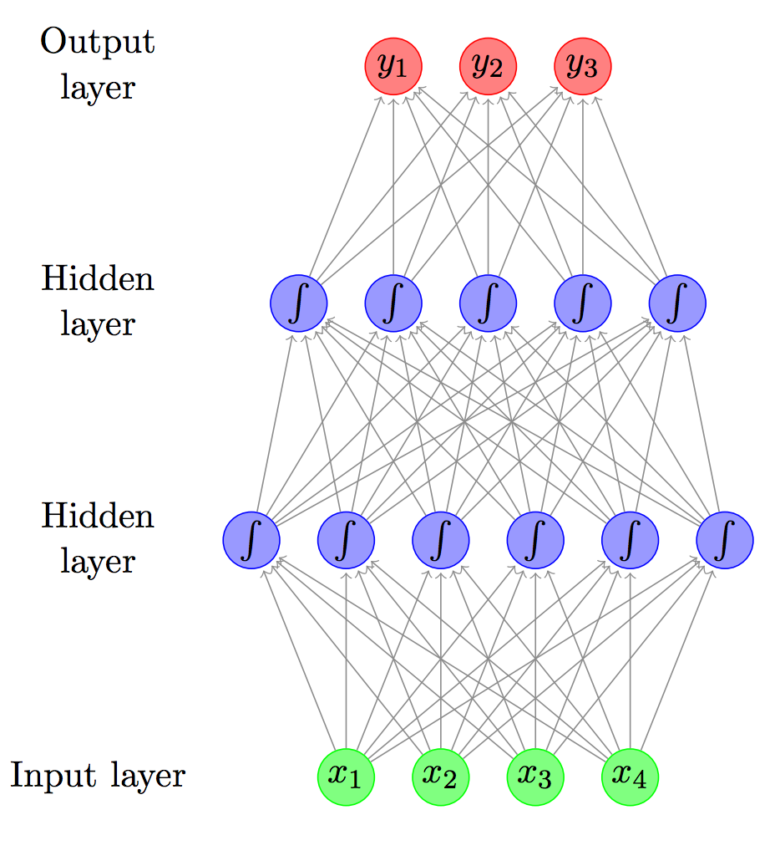
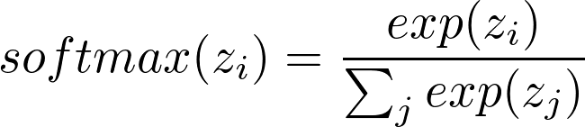
Method
Prediction Modelling
Feed Forward Neural Network
Keras library
Softmax output

Slide 22

Final Data Products
New Features:
Fundamental financial metrics:
Price/Earnings
Enterprise Value/EBITDA
Debt to Equity Ratio
Profit Margins
Text features:
Topic weights for each document
Sentiment score:
Polarity
Subjectivity
Uncertainty
Text features

Slide 23
Pipeline: Numeric Data
Fundamental Financial Data
Stock Returns Data
Subset Data
Create financial features script
Financial features DF
Create labels
Labeled DF

Slide 24
Pipeline: Text Document Data
SEC Filings
Extract documents
Filing List
Topic
modelling
Sentiment
analysis
Topic
Data Frame
Sentiment Data Frame
Merge data frames
Data Frame after
Natural Language Processing

Slide 25
Pipeline: Modelling
Labeled
Data Frame
Merge script
Data Frame after
Natural Language Processing
Split by year
Train Data Frame +
Test Data Frame
Logistic
Regression
Random Forest
Classification
Score
Score
K Nearest
Neighbor
Feed Forward
Neural Network
Support Vector
Machine
Score
Score
Score

Slide 26
Pipeline Overview
Fundamental Financial Data
Stock Data
SEC Filings
Extract documents
Subset Data
Filing List
Topic
modelling
Create financial features script
Sentiment
analysis
Financial features DF
Topic DF
Sentiment DF
Create labels
Merge script
Merge data frames
Labeled Data Frame
Data Frame after
Natural Language Processing
Split by year
Fit and train
models
Train + Test
Fit and train
models
Score
Score

Slide 27
Final Data Products
Topic weights
Sentiment score
Financials
Predictive model
Predictive Models
Several classical machine learning models
Logistic Regression
Random Forest Classifier
k-Nearest Neighbor
Support Vector Machine
Feed Forward Neural Network

Slide 28
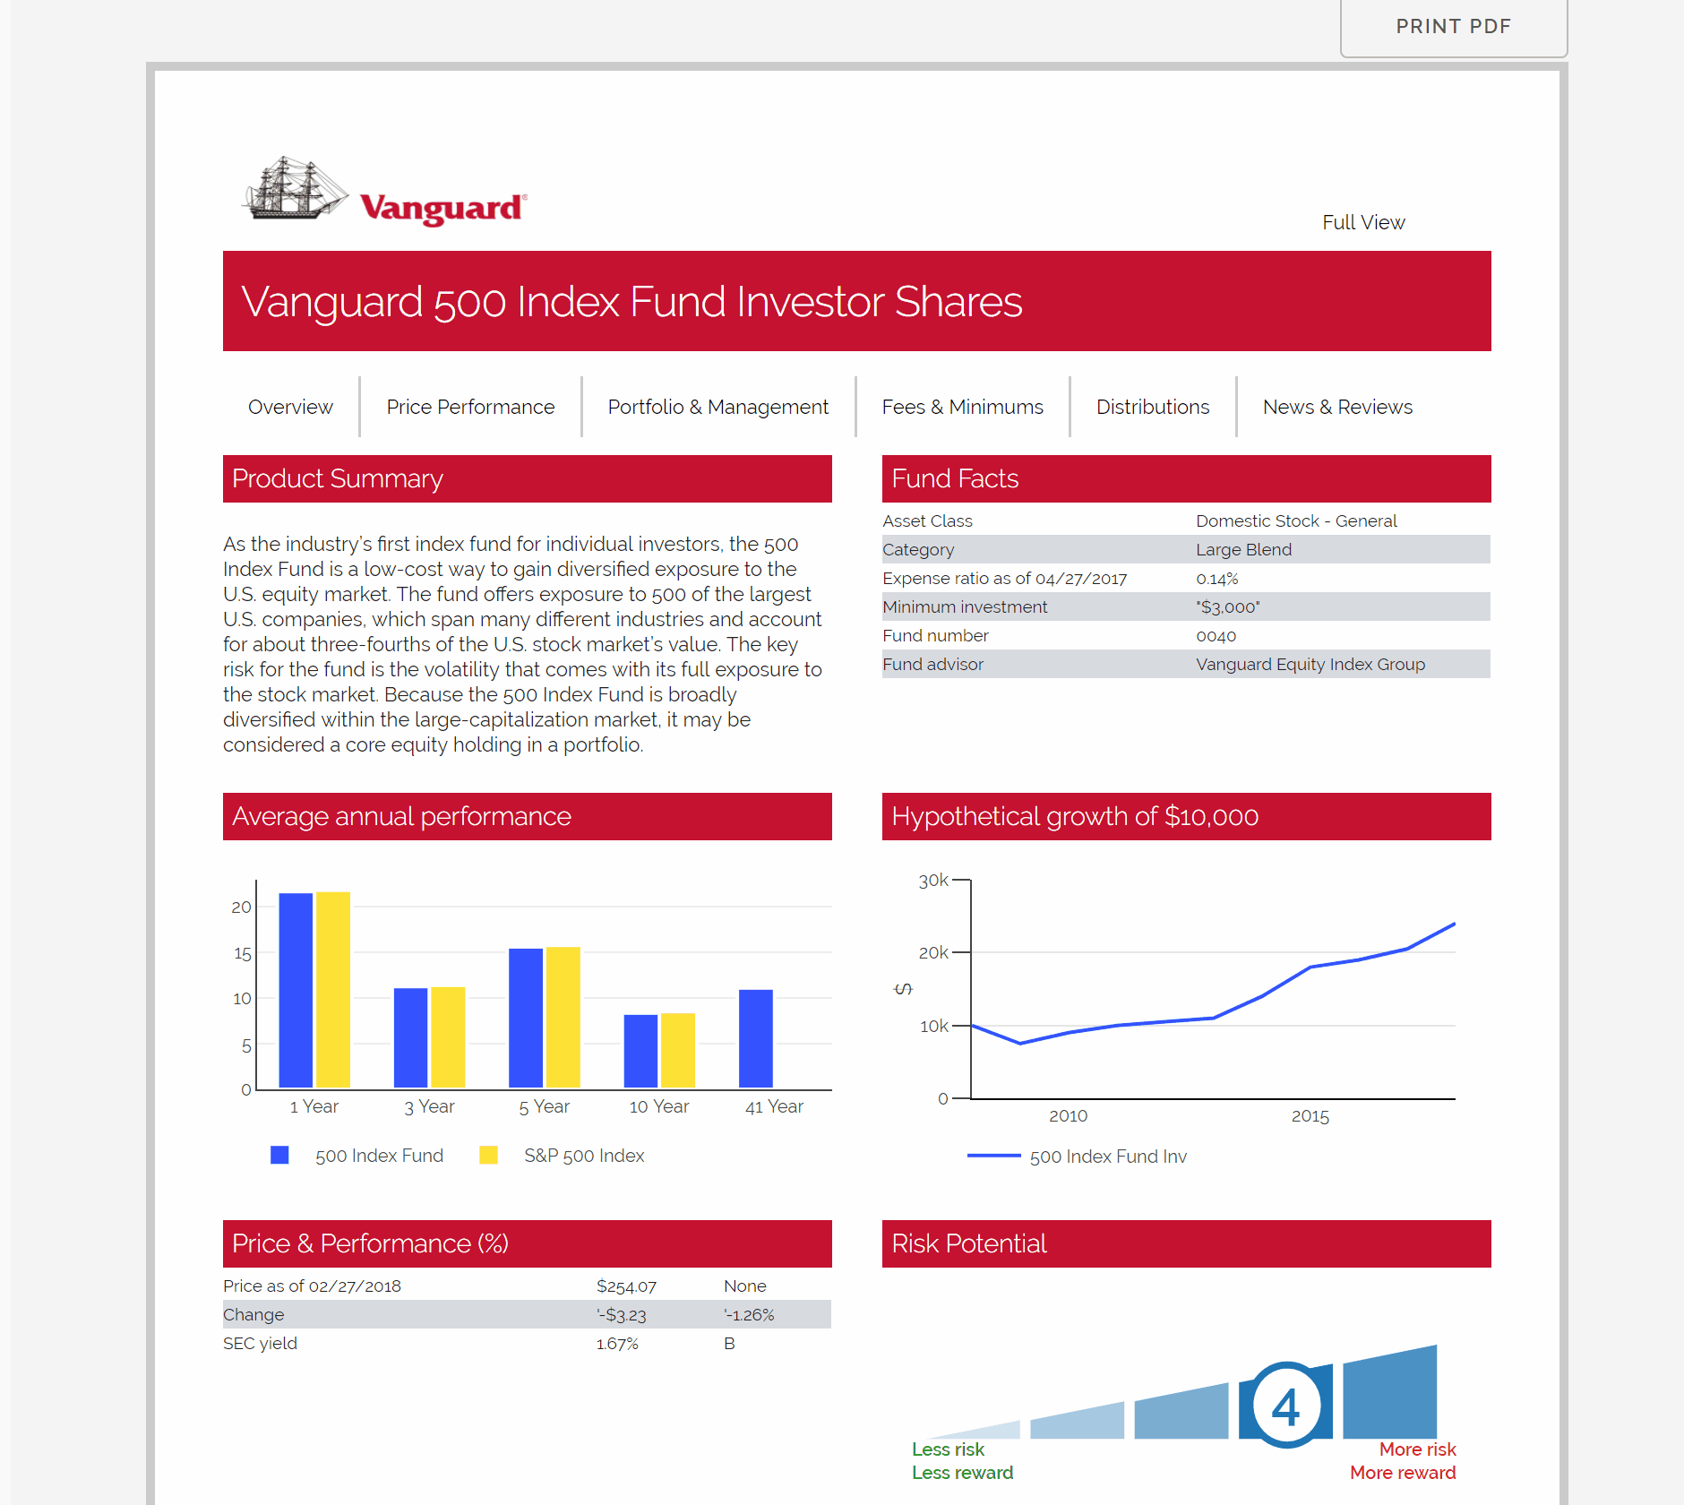
Future Work
Pre-processing
Building a dashboard
Impute data instead of Complete Case
✗ mean or median imputation
✓ Need to consider firms and time
Better treatment of confounding variables such as industry or year

Slide 29




Future Work
Pre-processing
The topics or sentiment in Item 1 may be overwhelmed by the discussion of business operations

Slide 30
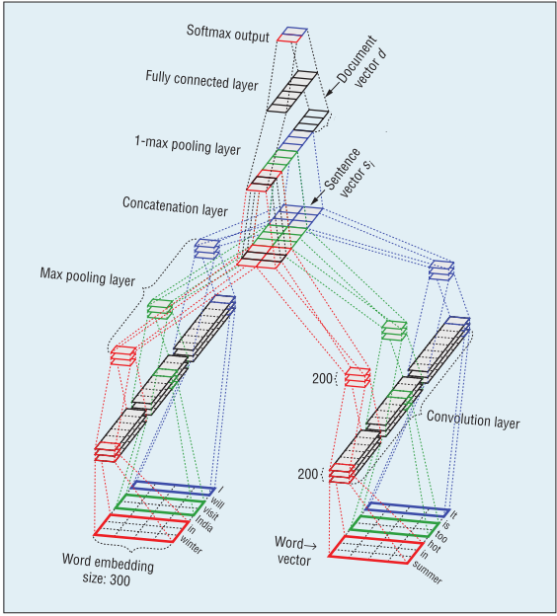
Future Work
Pre-processing
Item 1A (Risk Factors) 's focus on business risks.
Embedding spaces: doc2vec, word2vec, etc

Slide 31
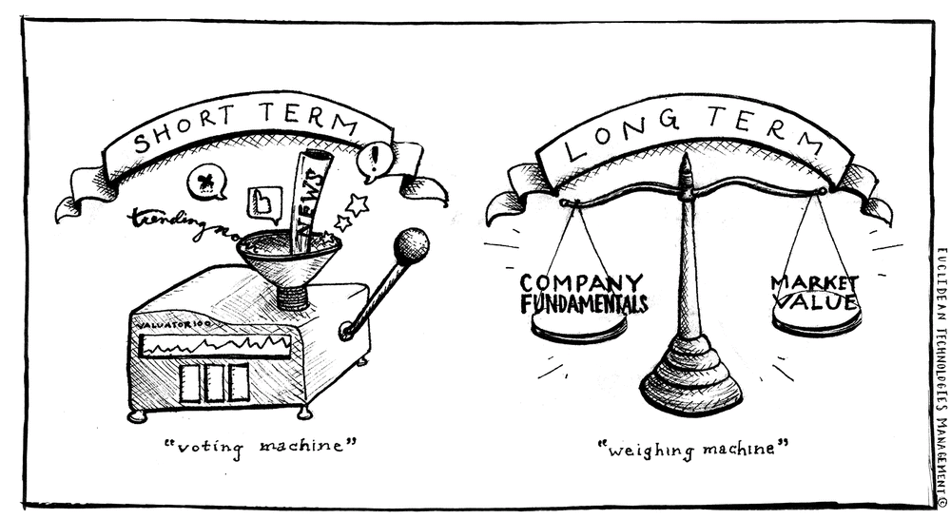
Future Work
Modelling
Model on different investment spaces

Slide 32




Future Work
Modelling
Extend text analysis to:
Other types of SEC filings: 10-Q, 8-K, 4, etc.
News and Social Media data
Pipeline with firm survival analysis

Slide 33
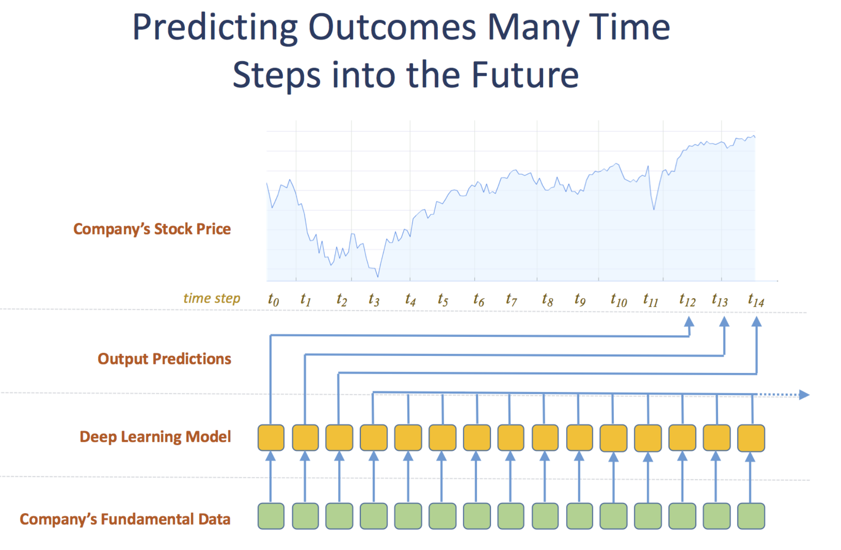
Future Work
Recurrent Neural Network

Slide 34
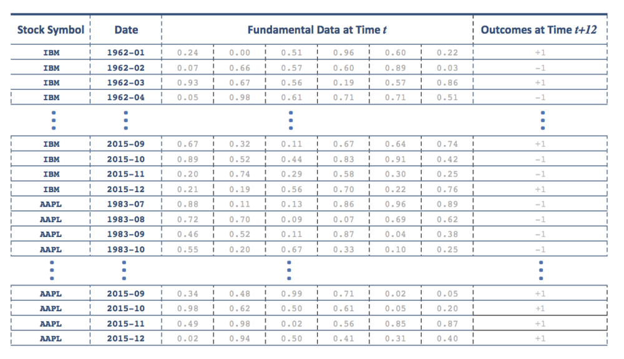
Future Work: Recurrent Neural Network

Slide 35


Cảm ơn

Slide 36
References
Alberg, J., & Lipton, Z. C. (2017). Improving Factor-Based Quantitative Investing by Forecasting Company Fundamentals, (Nips). https://doi.org/10.1109/ICCV.2017.627
Donaldson, D., & Storeygard, A. (2016). The View from Above: Applications of Satellite Data in Economics. Journal of Economic Perspectives, 30(4), 171–198. https://doi.org/10.1257/jep.30.4.171
Kogan, S., Levin, D., Routledge, B. R., Sagi, J. S., & Smith, N. a. (2009). Predicting Risk from Financial Reports with Regression. Proceedings of North American Chapter of the Association for Computational Linguistics, 272–280. https://doi.org/10.3115/1620754.1620794
Lee, G. M., Nigam, Y., Kapoor, D., & Seo, J. (2017). SEC Filings Text Analytics for U . S . Industry Intelligence : A Preliminary Report, 1–6.
Li, K. K., & Mohanram, P. (2014). Evaluating cross-sectional forecasting models for implied cost of capital. Review of Accounting Studies, 19(3), 1152–1185. https://doi.org/10.1007/s11142-014-9282-y
Loughran, T., & Mcdonald, B. (2016). Textual Analysis in Accounting and Finance: A Survey. Journal of Accounting Research, 54(4), 1187–1230. https://doi.org/10.1111/1475-679X.12123

Slide 37
References
Mcdowell, B., Kong, L., Routledge, B. R., & Smith, N. A. (2014). Extracting a Corporate Social Network from Text, 1994.
Routledge, B. R., Sacchetto, S., & Smith, N. A. (n.d.). Predicting Merger Targets and Acquirers from Text. Working Paper, 1–16.
Shi, Z., Lee, G. M., & Whinston, A. B. (2016). Toward A Better Measure of Business Proximity: Topic Modelling for Industry Intelligence. Main, 40(4), 1035–1056.
Xiang, G., Zheng, Z., Wen, M., Hong, J., & Rose, C. (2005). A Supervised Approach to Predict Company Acquisition with Factual and Topic Features Using Profiles and News Articles on TechCrunch. Artificial Intelligence, 607–610.
Zhu, C. (2018). Big Data as a Governance Mechanism. Job Market Paper.

